Slide 1
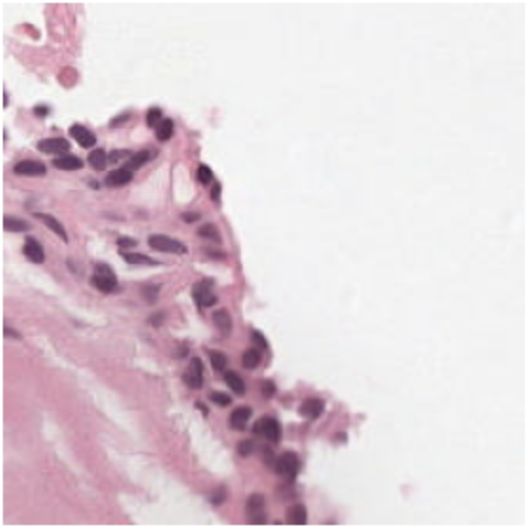
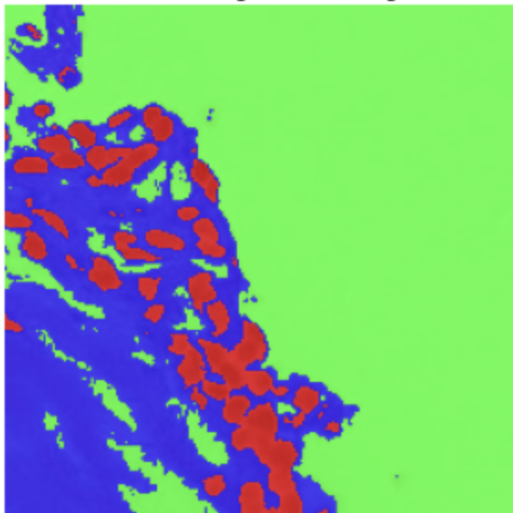
AI Campus Cedars
Team 6 Introductory Meeting: Semantic Segmentation of Prostate Cancer
Biopsy Tissue Using Deep Learning
PANDA (Prostate Cancer Grade Assessment) Challenge
Omar Lab
Department of Computational Biomedicine
Assistant Coaches: Okan Ozdemir and Rish Sharma
March 25, 2025
Semantic Segmentation

Slide 2
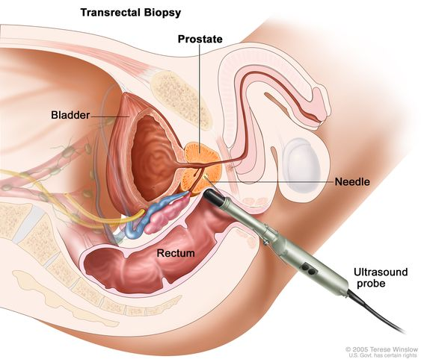
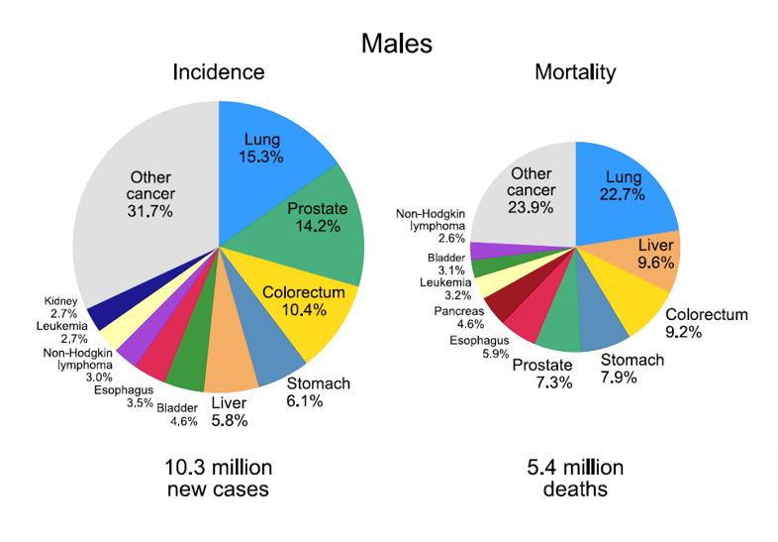
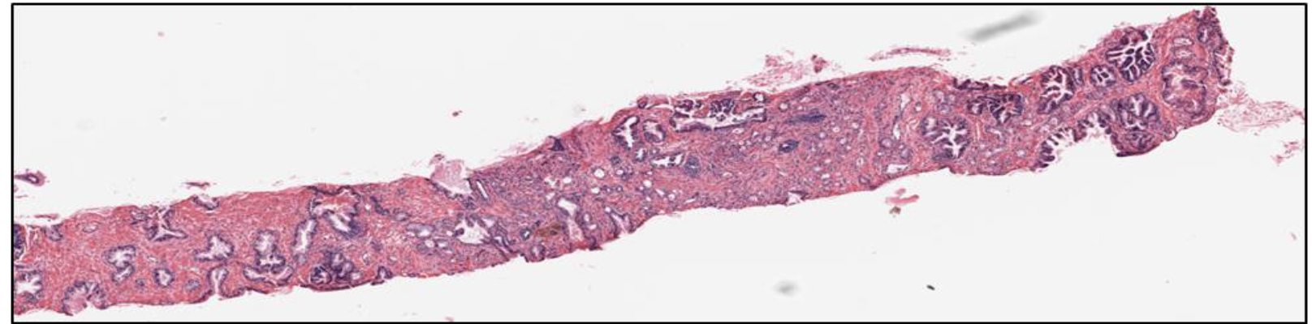
Prostate Cancer & Gleason Grading
Prostate Cancer is the second most diagnosed non-skin cancer in men worldwide (1st in the US)
Diagnosis is made using biopsy samples examined under the microscope by a pathologist

Slide 3
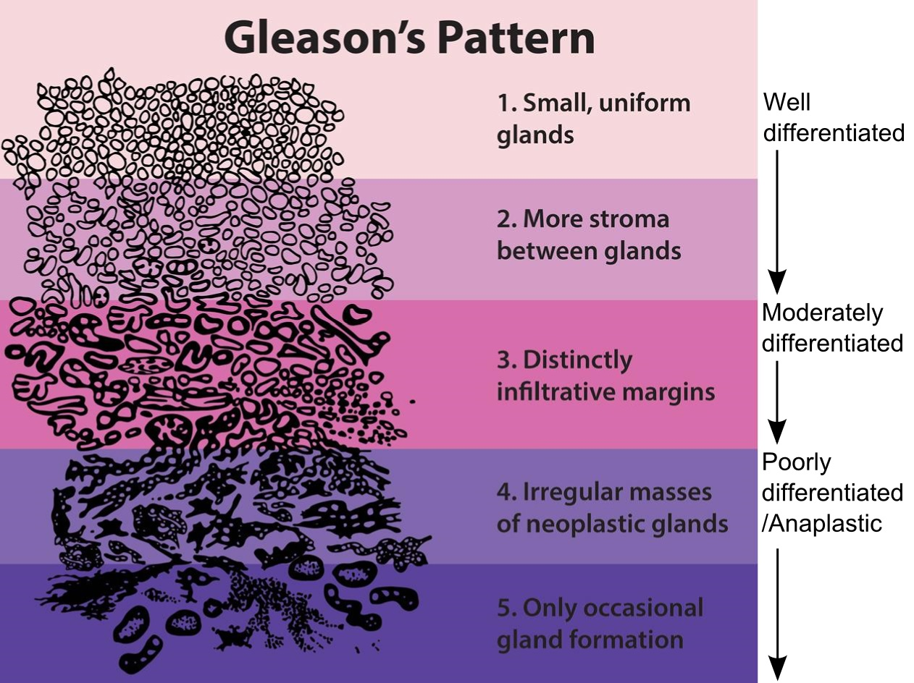
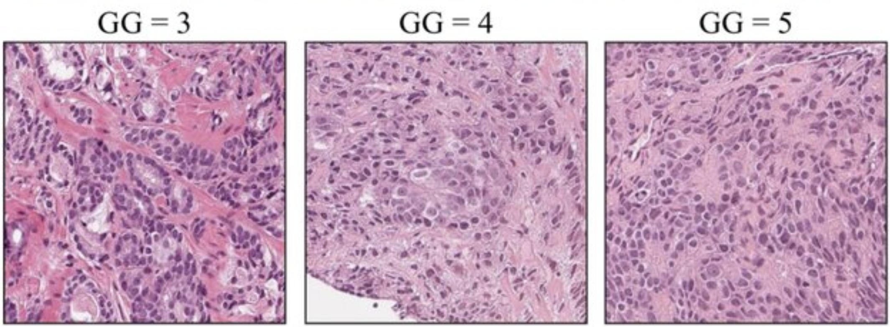
Prostate Cancer & Gleason Grading
The Gleason grading system is used to assess how aggressive the cancer is, based on glandular architecture seen in H&E-stained biopsy tissue. This grade influence treatment decisions: surveillance vs surgery/radiation.

Slide 4
Why Automate Tissue Segmentation?
Manual Gleason grading is time-consuming and subject to interobserver variability, especially between intermediate grades.
Automated segmentation into benign epithelium, stroma, and Gleason patterns will: a) standardize diagnosis, and b) enable large-scale analysis across thousands of cases

Slide 5
Goals and Motivation
Gain familiarity with semantic segmentation using supervised and unsupervised machine learning on prostate cancer biopsy tissue imaging data from the PANDA challenge
Introduction to associated tools and frameworks for image processing, visualization, and deep learning (PyTorch, OpenCV, NumPy, tifffile, etc.)
Introduction to applied hyper-parameter tuning (Optuna) for machine learning models
Introduction to dataset preparation using PyTorch dataset class and data loaders
Introduction to data normalization and image data augmentation techniques for dataset size enhancement
Understanding intuition behind loss functions and evaluation metrics to train and assess semantic segmentation results
Introduction to unsupervised image segmentation using K-means clustering, which does not rely on labelled data to train

Slide 6
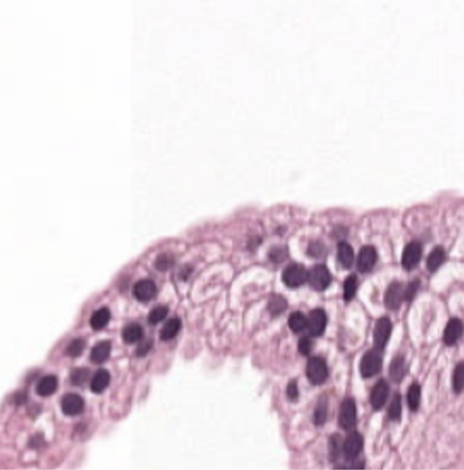

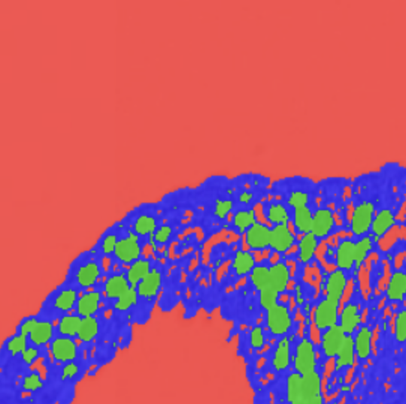
Overview and Motivation for Semantic Segmentation
Aims to classify each pixel in an image into a pre-defined class, grouping similar pixels together into meaningful segments
Label every pixel in an image by a single class (hard label) or by a probability distribution over the classes (soft label)
Interpret images in a relatively human-like manner by identifying spatial relationships between objects
A data-driven segmentation model can contribute to standardizing whole-slide image annotation process by disease severity classes and mitigate ambiguation/inter-observer variability by providing consistent ratings
Challenging area for pathology: Experienced experts often disagree on slide interpretation
Original Image
3-class segmentation

Slide 7
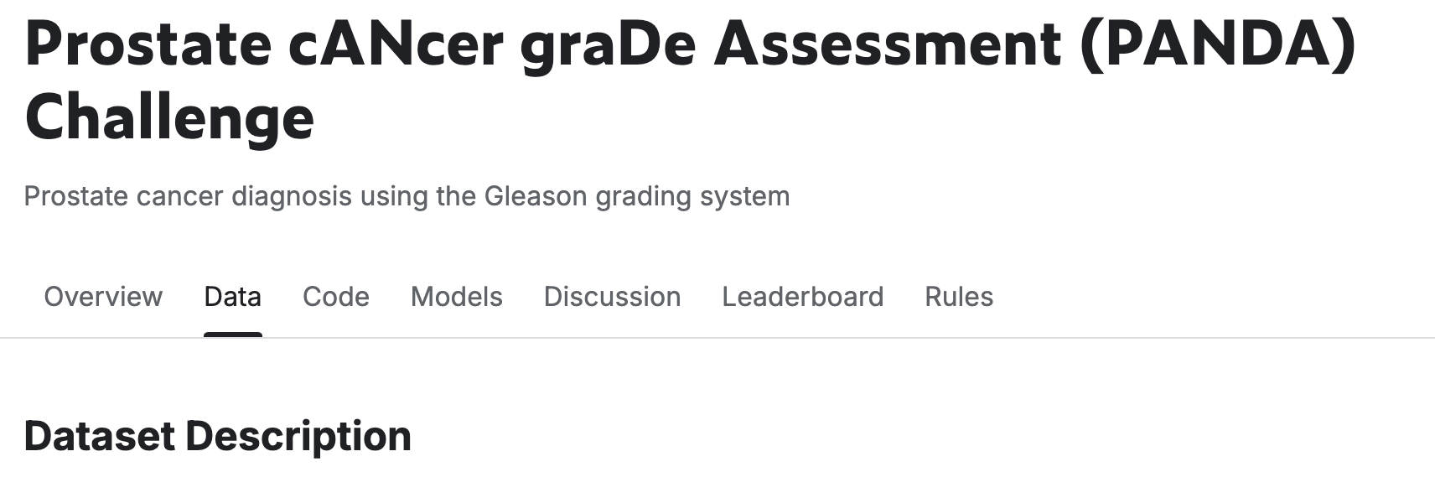
Dataset Overview (PANDA challenge)
Classify the severity of prostate cancer from microscopy scans of prostate biopsy samples
10,616 digitized biopsies in total, collected from two sites (Radboud and Karolinska)
Biopsy specimens are characterized into one of five groups (Radboud)
0: background (non-tissue) or unknown 1: stroma (connective tissue, non-epithelium tissue) 2: healthy (benign) epithelium 3: cancerous epithelium (Gleason 3) 4: cancerous epithelium (Gleason 4) 5: cancerous epithelium (Gleason 5)

Slide 8
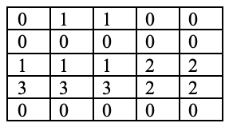
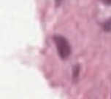
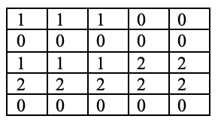
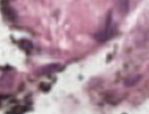
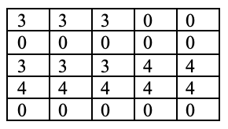
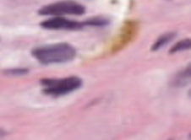
Dataset Overview (Image and Mask Pairs)
0: background (non-tissue) or unknown 1: stroma (connective tissue, non-epithelium tissue) 2: healthy (benign) epithelium 3: cancerous epithelium (Gleason 3) 4: cancerous epithelium (Gleason 4) 5: cancerous epithelium (Gleason 5)

Slide 9
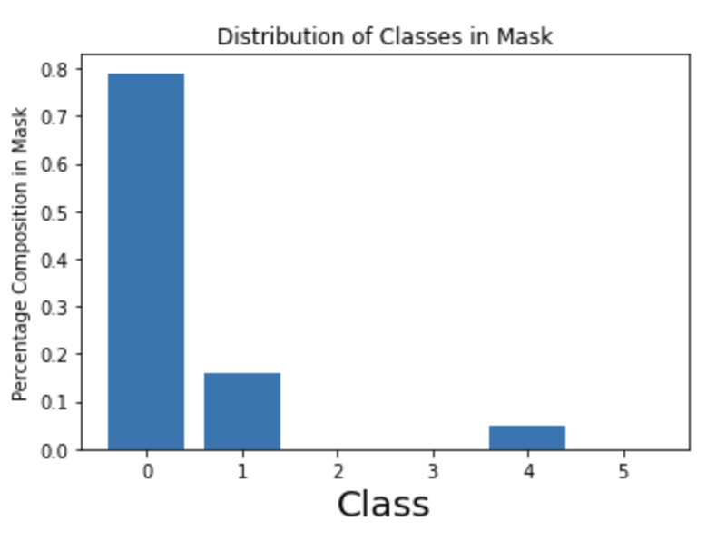
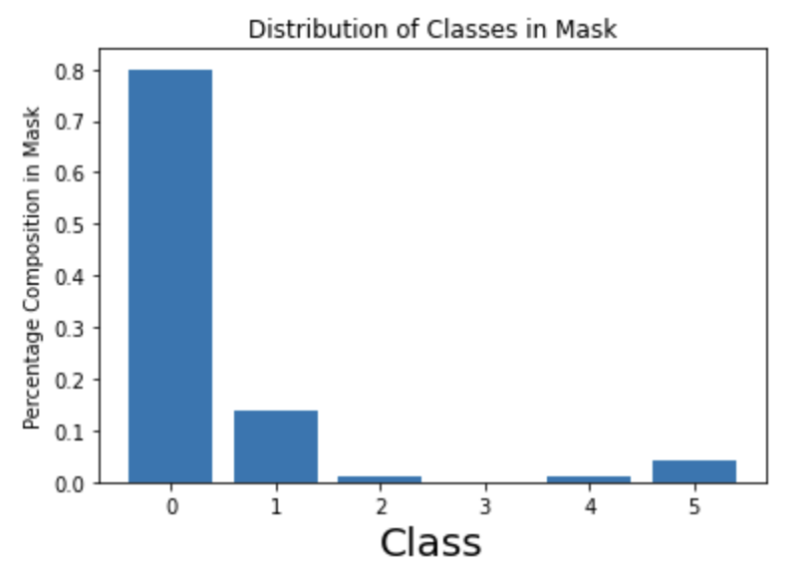
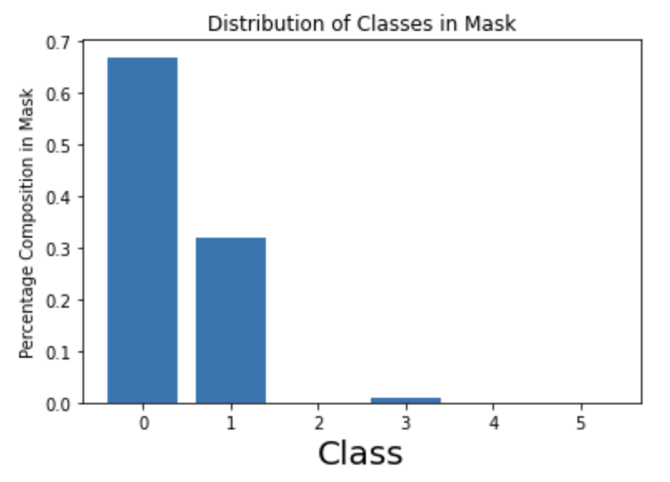
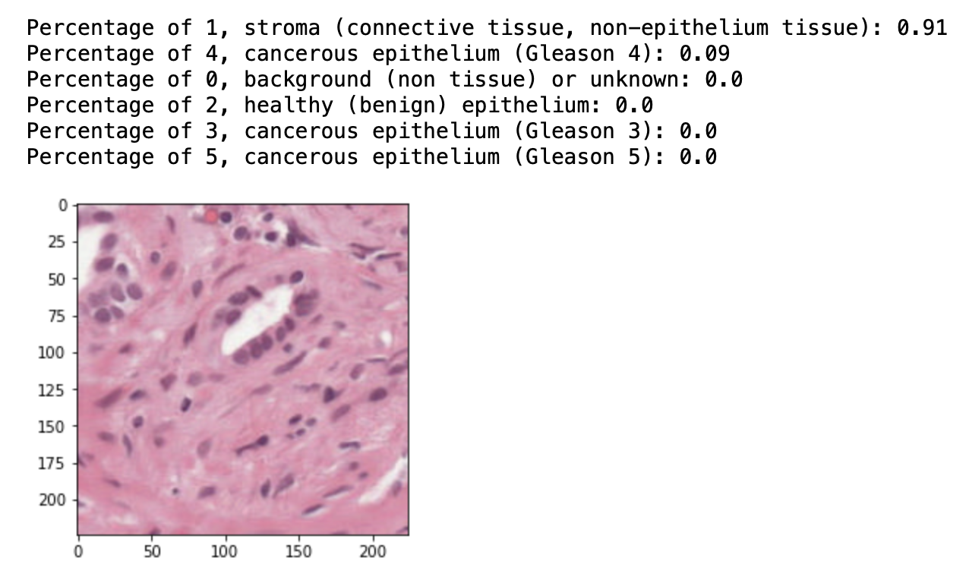
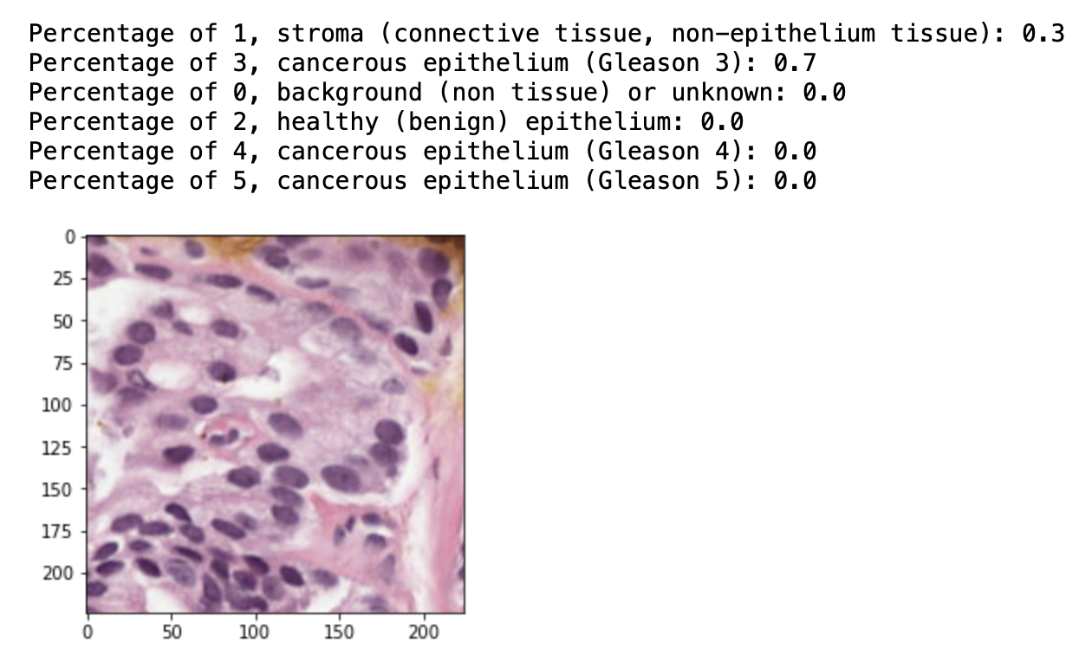
Dataset Overview (Presence and Distribution of Classes in Images and Masks)
…
…

Slide 10
Overview of Modules Prepared for Training
Module 1: Loading of slides and masks
Module 2: Data Visualization
Module 3: Image Pre-processing using normalization
Module 4: PyTorch dataset class and data loaders
Module 5: Image (Tile) Data Augmentation
Module 6: Loss function and metrics for semantic segmentation
Module 7: Unsupervised image segmentation using k-means clustering
Upcoming Planned Modules…
Pixel-wise SoftMax classifier for segmentation
Supervised models for Semantic segmentation: U-Net (CNN-based), ViT, etc.
Semantic segmentation using additional unsupervised clustering techniques (DBSCAN, Mean-shift, OPTICS)

Slide 11
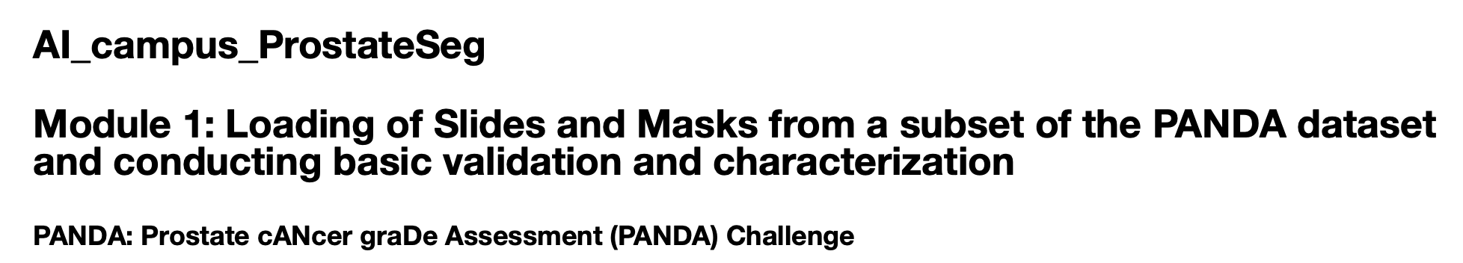
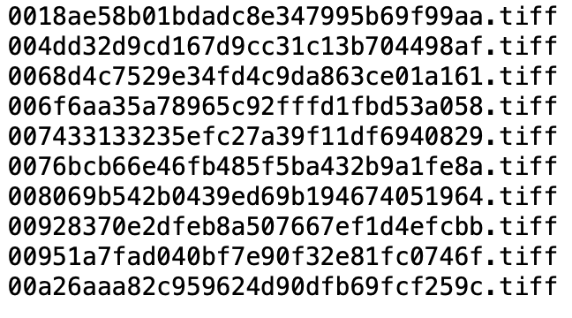
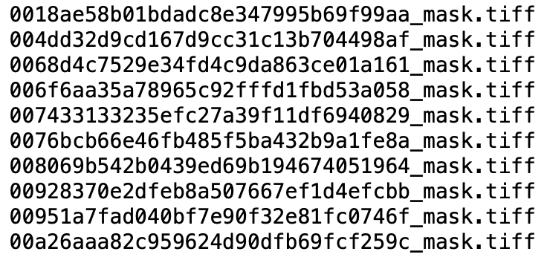
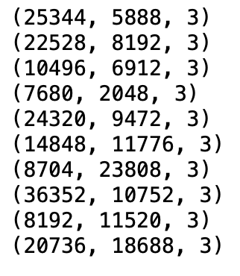
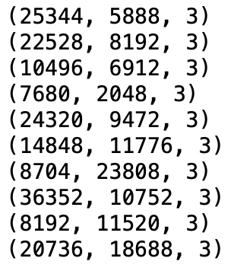
Module 1: Loading of Slide-Mask Pairs
Coupled image and mask files dataset
Matched dimensions

Slide 12
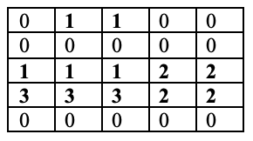

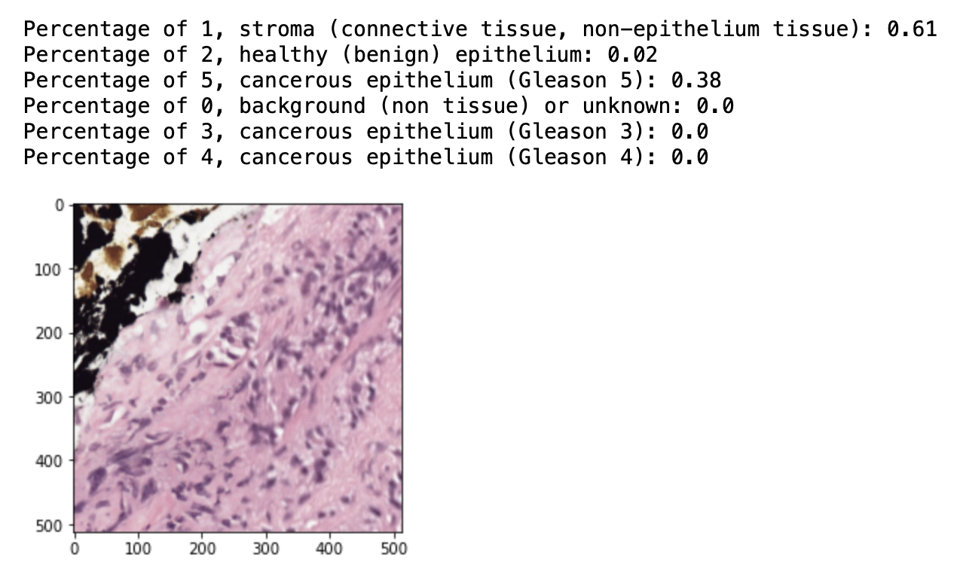
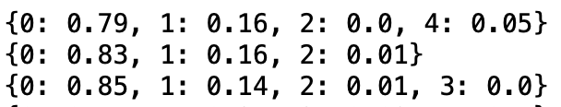
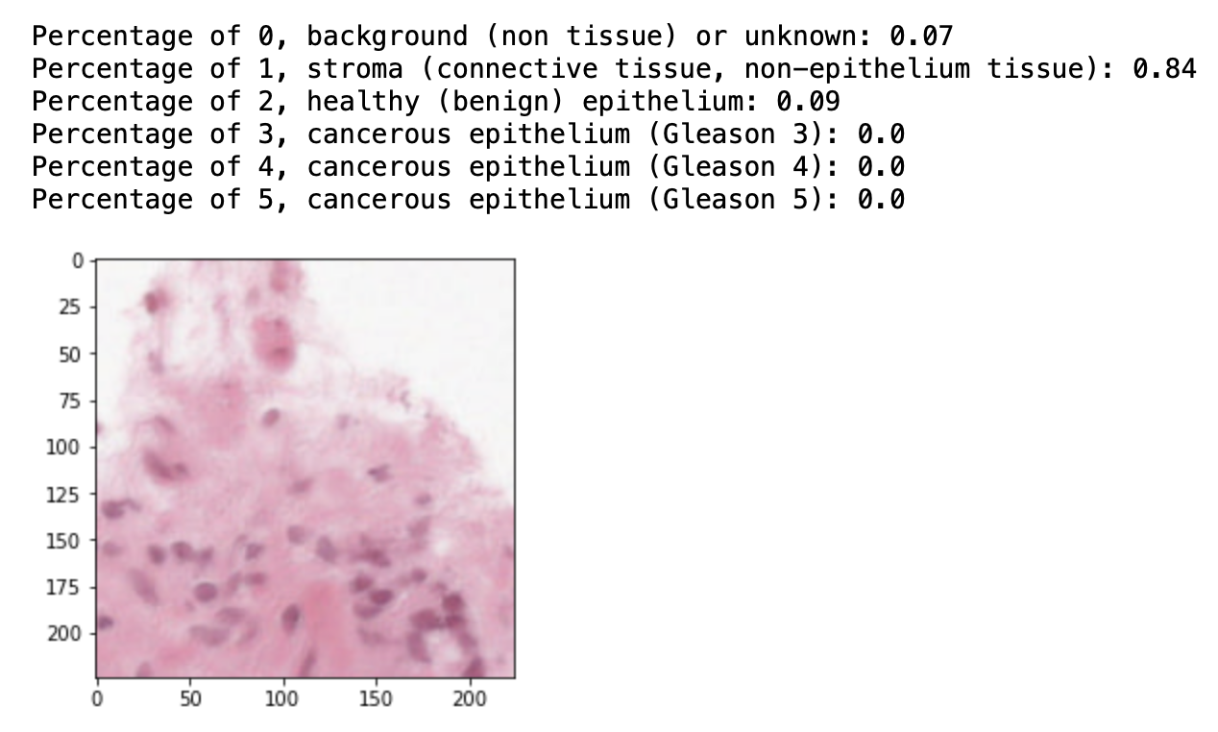
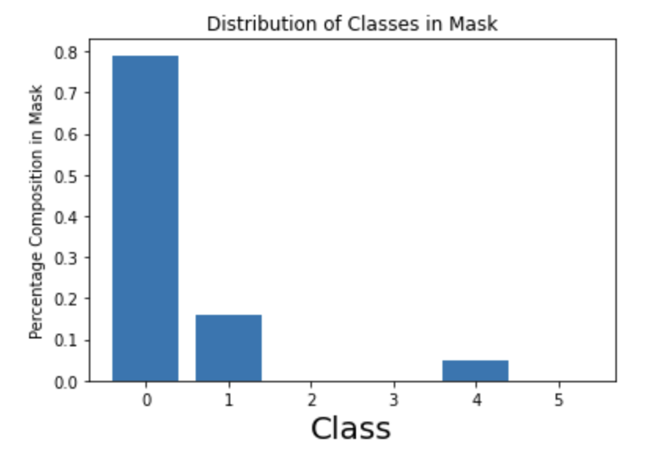
Module 2: Data Visualization and Exploratory Data Analysis
Summary of signal to background ratios in masks
Tile-wise plots by distribution of classes
Summary of class presence in masks
Summary of class distributions in masks

Slide 13
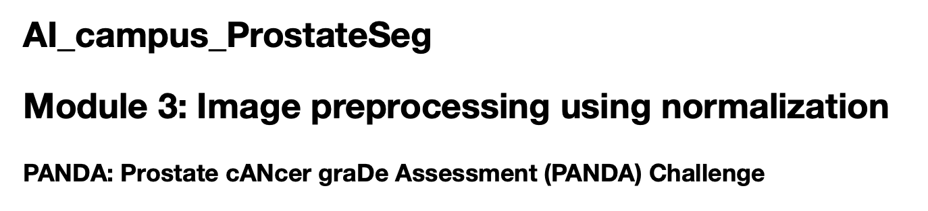
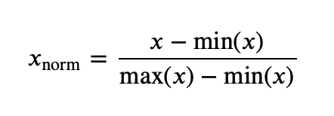
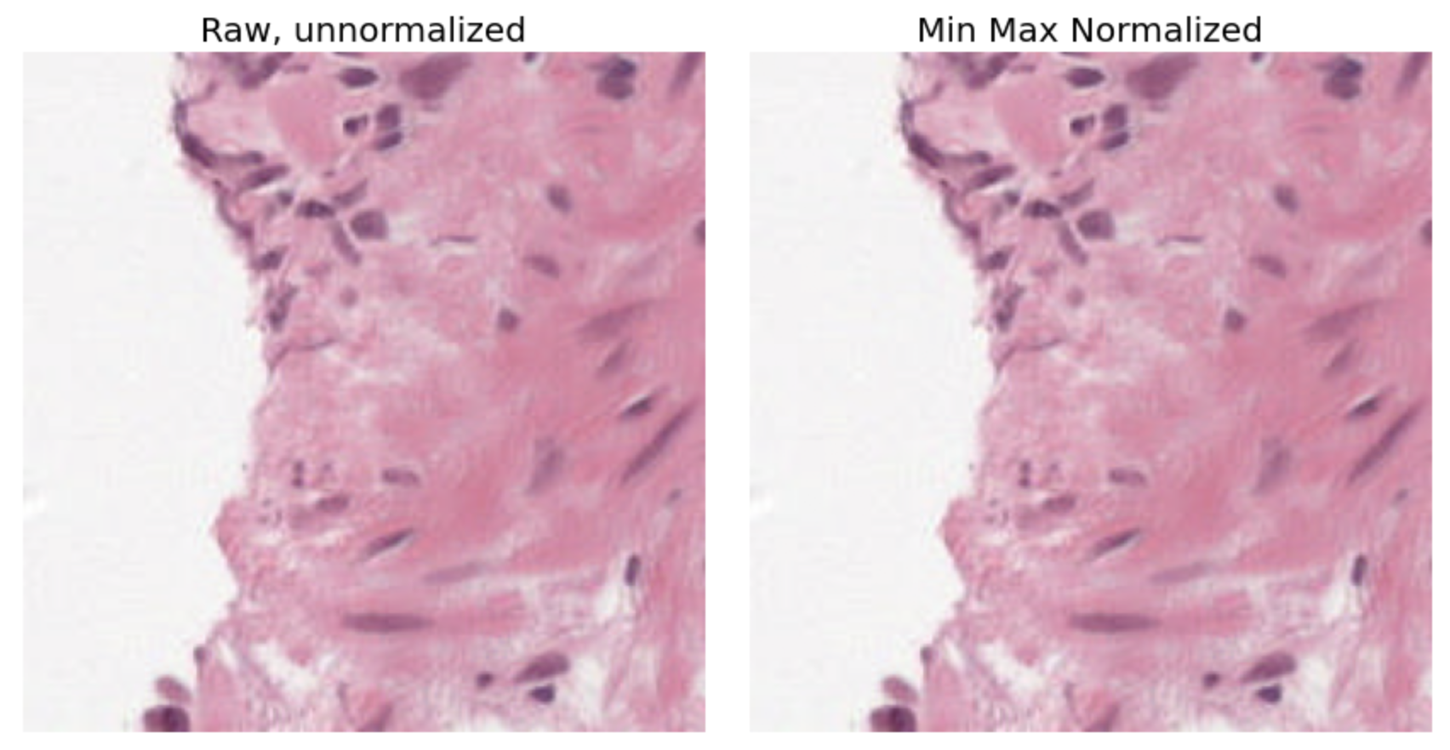
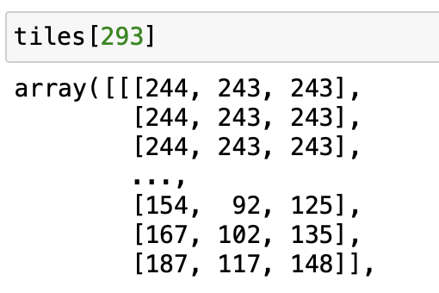
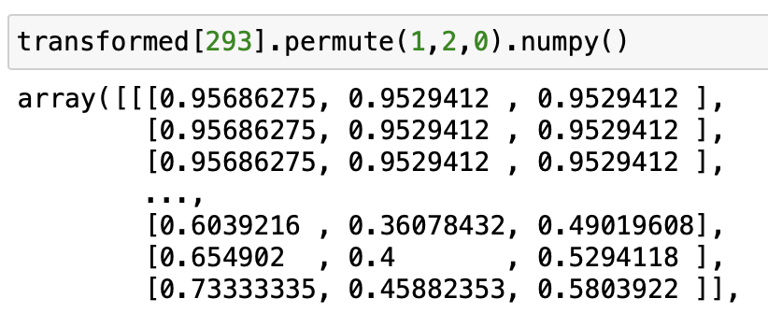
Module 3: Image Pre-Preprocessing Using Normalization
Min-max normalization
Channel-wise normalization

Slide 14
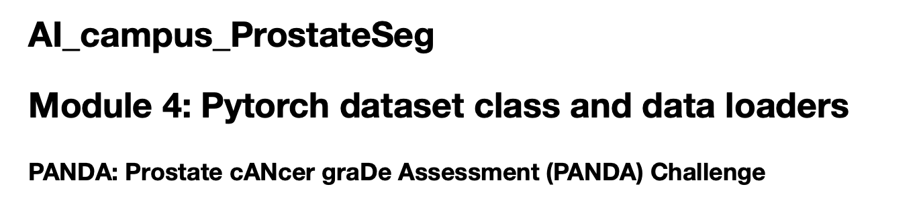
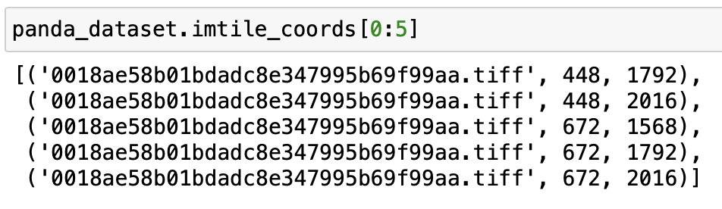
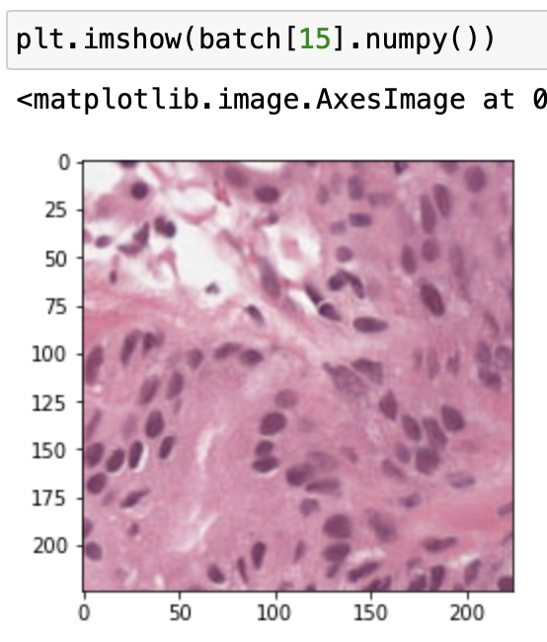
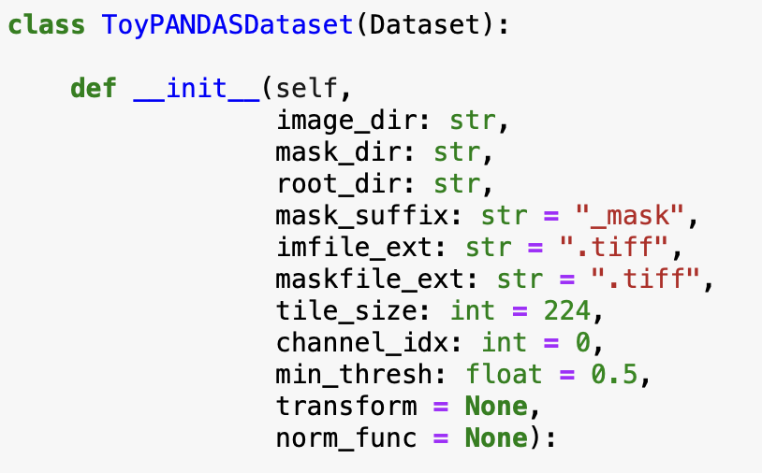
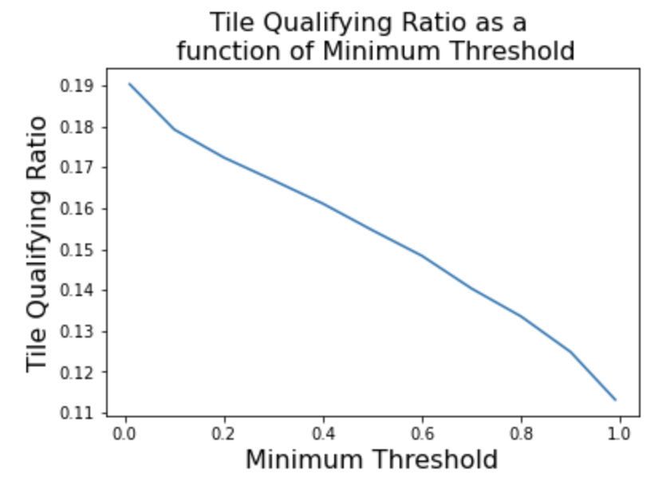
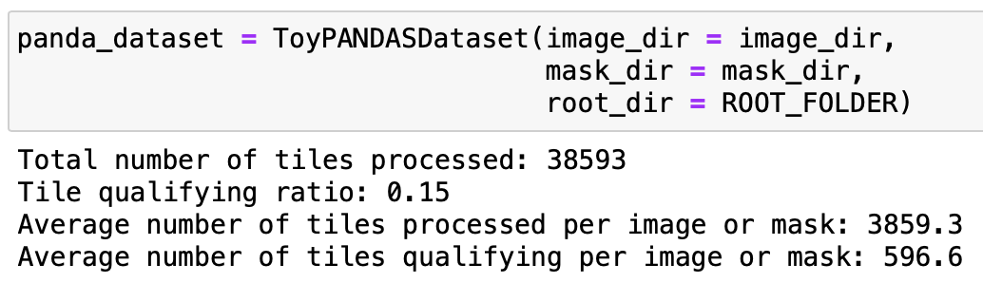
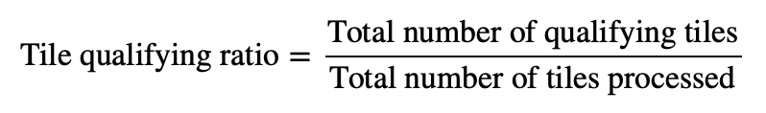
Module 4: PyTorch Dataset Class and Data Loaders
Dataset class iterates over image tiles, tuple contains image file and tile coordinates
Example tile
Custom dataset class
Tile-wise processing of PANDA dataset images

Slide 15
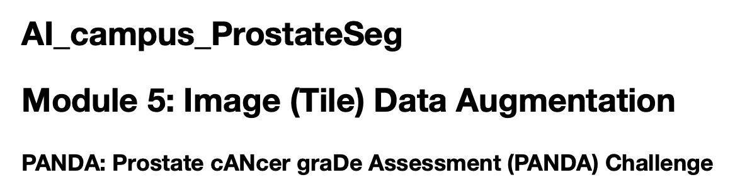
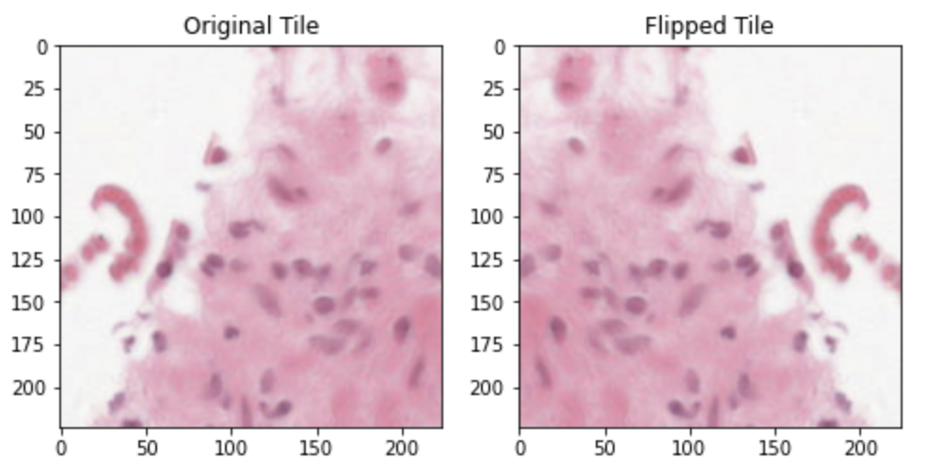
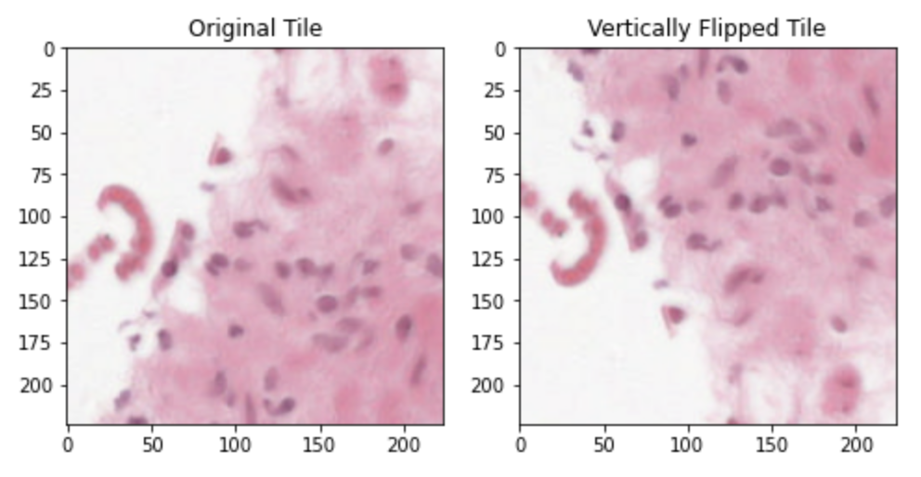
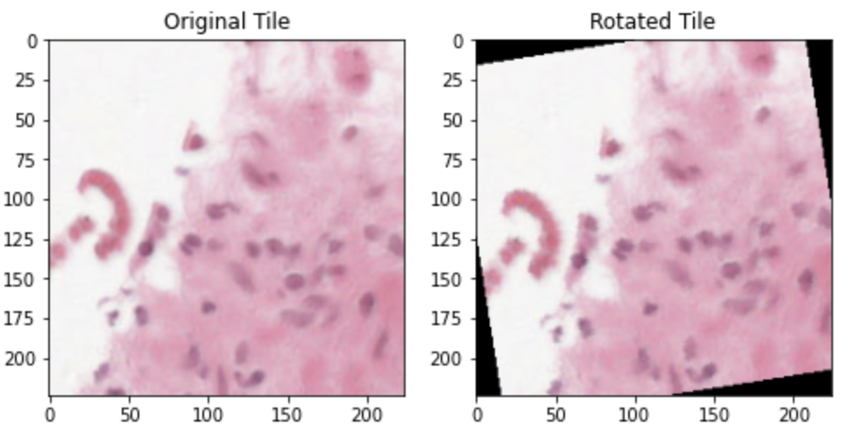
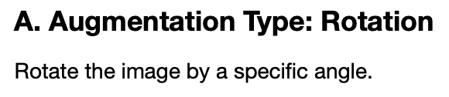
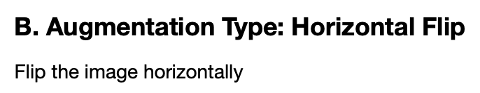
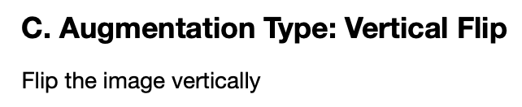






Module 5: Image (Tile) Data Augmentation

Slide 16













Module 6: Loss Function and Metrics for Semantic Segmentation
IOU=1.0
Ground truth mask
Predicted mask
IOU=0.33
Ground truth mask
Predicted mask
IOU=0.00
Ground truth mask
Predicted mask
Intersection over Union between ground truth and predicted mask pairs

Slide 17





Module 7: Unsupervised Image Segmentation Using K-means clustering

Slide 18

Current Repository Overview
Modules 1-7
Utility files and helper functions:
Dataclass.py
Normalizers.py
Panda_utils.py

Slide 19
Thank You: Comments or Questions?
Any other concepts or topics you would like to see covered in the modules?
Preferred format for modules, etc.
Administrative: Weekly Meeting Scheduling for Discussing Modules
Tuesday (2-3 pm), 8 of 10 available

